Slide 1
Pillar 1- Make Adoption Easier
Journey Roadmap Workstream
PI-21 Community Meeting - progress update
March 2023 Kigali

Slide 2
PI-21 Workstream Readout Summary
Workstream Name: | Journey Roadmap
Roadmap Pillar: | 1 Make Adoption easier
Lead: | Jane Stroucken
Workstream Objectives: | Development of an outline with important milestones for the deployment of a new national or subnational payments Hub based on Mojaloop.
Progress Against Objectives: | To follow in the next slides
Issues: | Time and contributor members availability
(If not completed) Plans for Next PI: | To complete: Executive Series Influencer List The Path to a POC

Slide 3
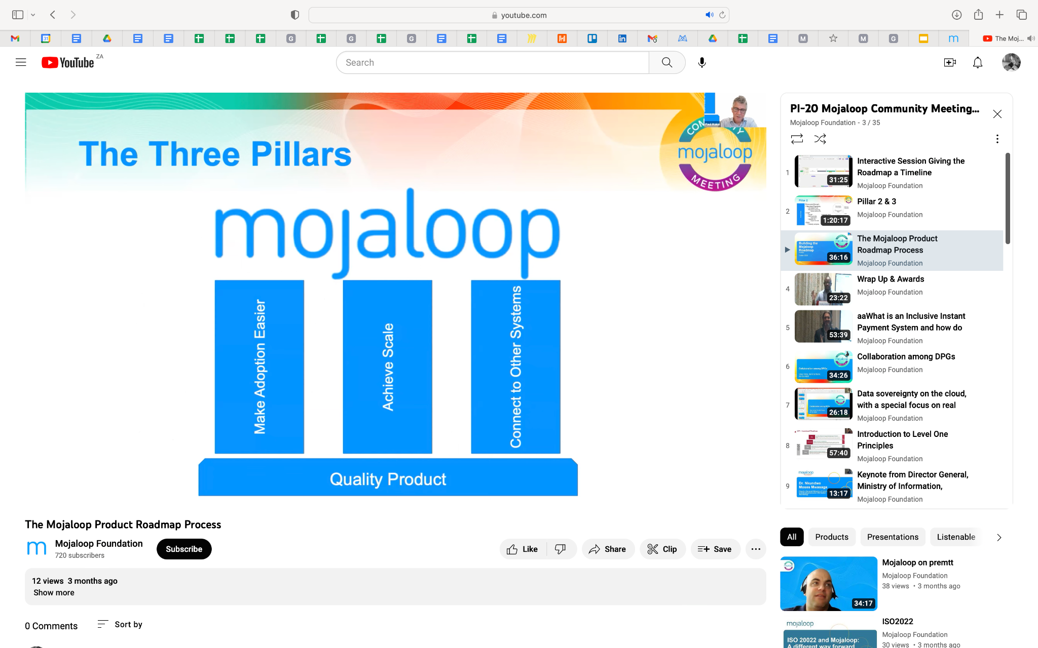
Context
Primary Goal for the Journey Roadmap Workstream -
Development of:
an outline,
contents list,
draft engagement strategy,
timeline with important
milestones for the deployment
of a new national or
subnational payments Hub
based on Mojaloop.

Slide 4
High Level view
Initial ‘cover page’ view - Roadmap/Journey Map that outlines
the optimal route that can be taken to deploy a Mojaloop Switch.
At touch points/decision points on the roadmap the 'clickable' point will take the user to:
Executive Series videos
Example/Templates:
Business Case document
Engagement guidelines
Business Explainer document

Slide 5
Goal for PI-20 - Phase 1
Definition of done
List of tools available and needed
Identify community influencers
Map the path to a POC

Slide 6
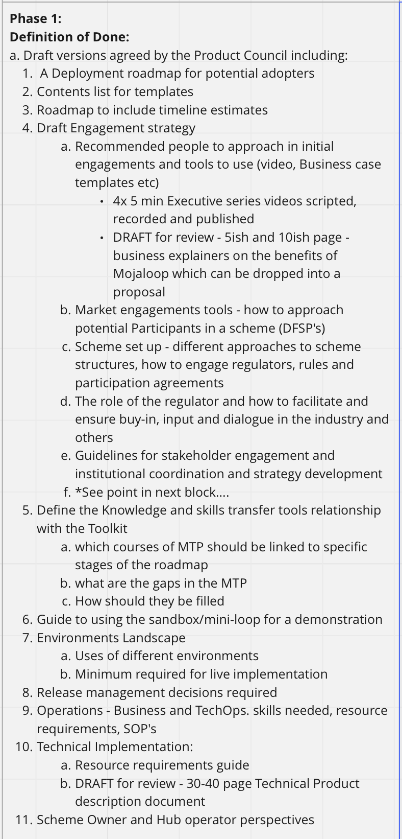
Definition of Done
Definitions can be seen on the Mural Board
Note: the definitions are evolving and changing as the work evolves

Slide 7
2. List of tools available and needed
Available:
Governance model for Schemes by Paul Makin
Mojaloop Training Program - https://mojaloop.io/mojaloop-training-program/
INFITX Journey - THE SCHEME MVP GOALS JOURNEY https://infitx.com/capacity-building/supporting-an-inclusive-instant-payment-system-build/
Mojaloop Lab - https://infitx.com/capacity-building/mojaloop-lab/
Needed:
Executive Series videos - outline complete
Standard templates for common
Community generated documentation for Operations etc - anything that you as community members feel will add value to making participation and adoption easier.

Slide 8
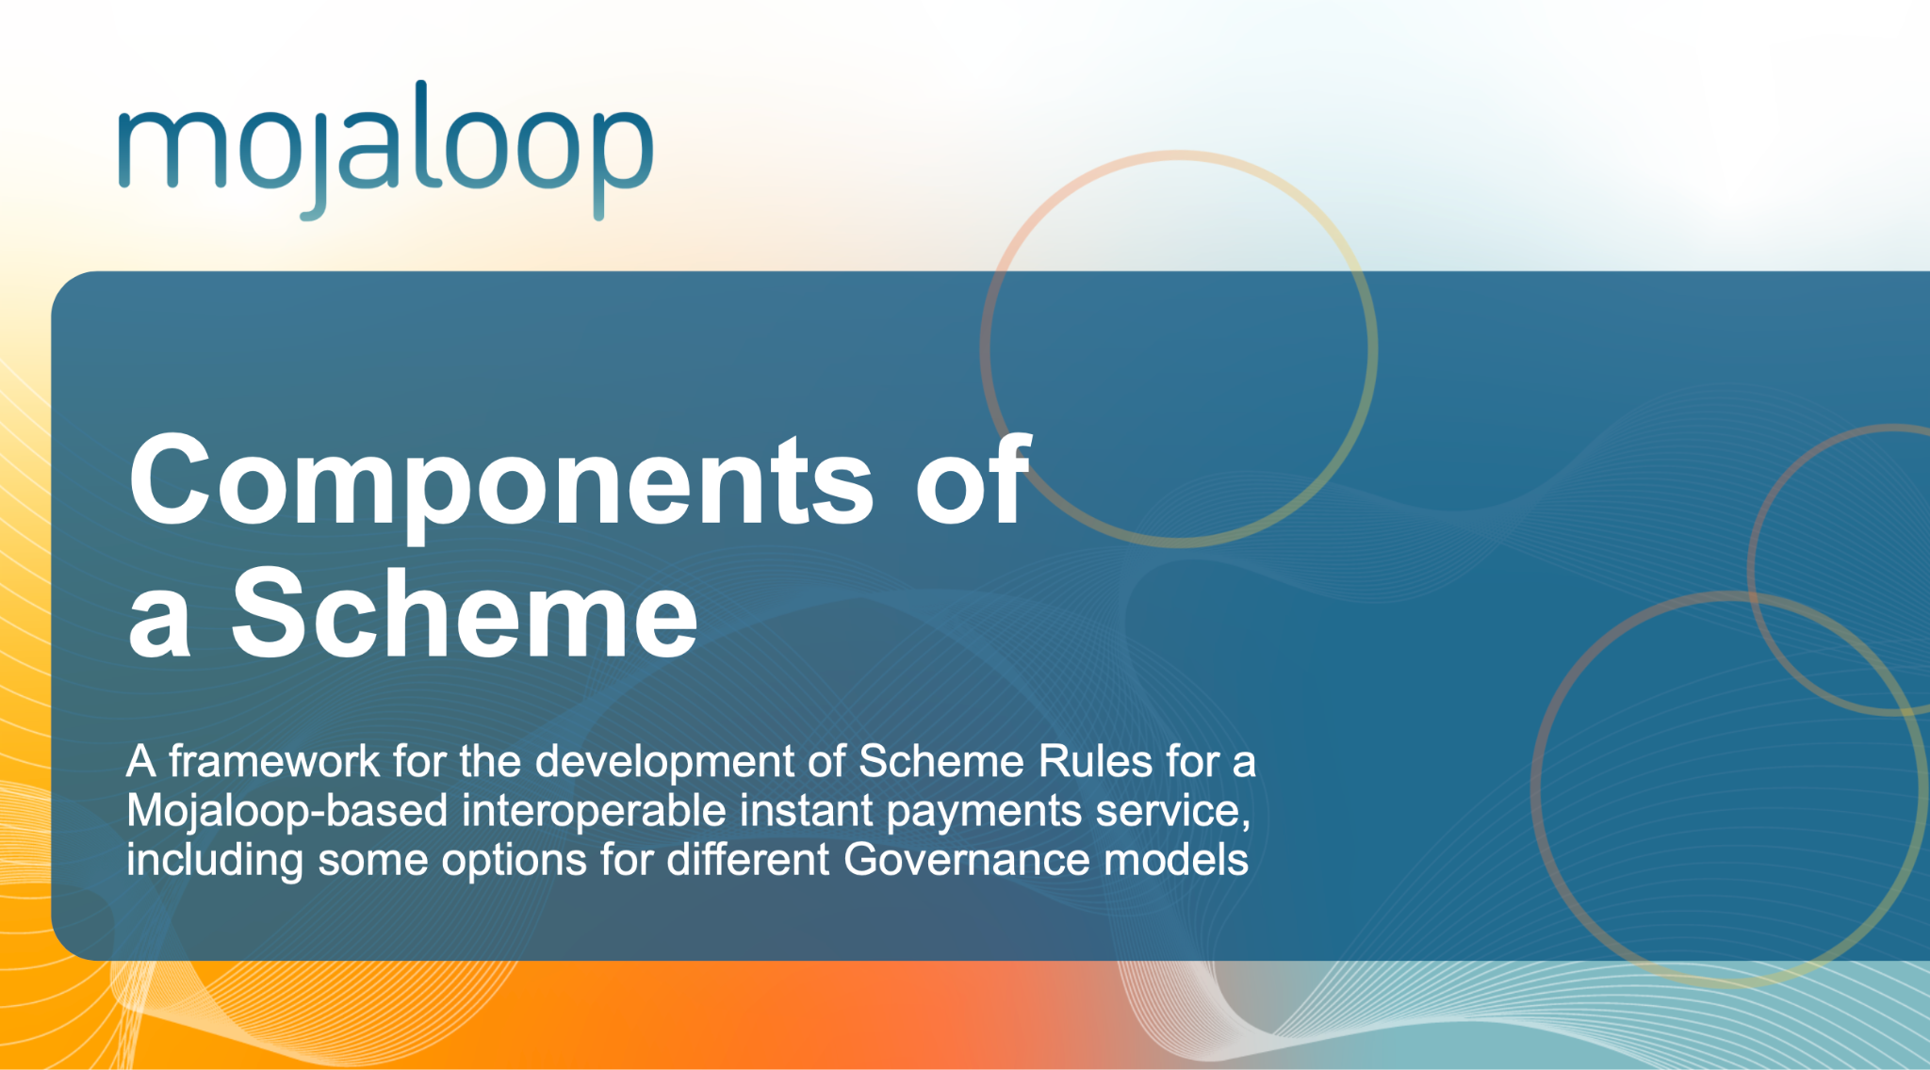
Available tools
Governance model for Schemes by Paul Makin https://docs.google.com/presentation/d/1j9Gu0zinxPJLya7QrCV3_hrMDdb7Ib7BLhSZ1Yd8Rjo/edit?usp=share_link

Slide 9
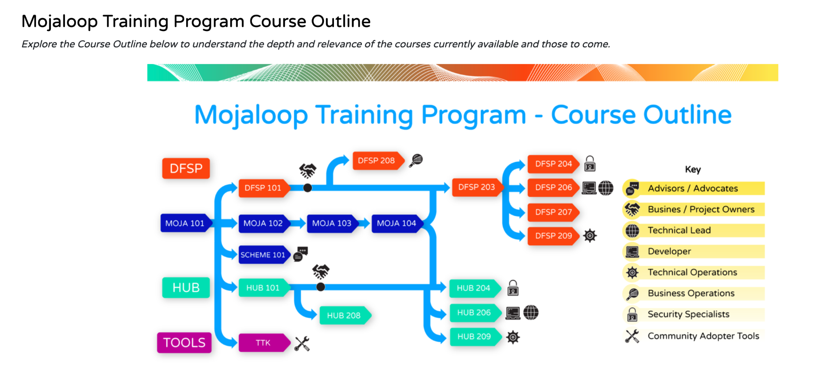
Available tools
2. Mojaloop Training Program - https://mojaloop.io/mojaloop-training-program/
Probably our most widely used tool at this stage.

Slide 10
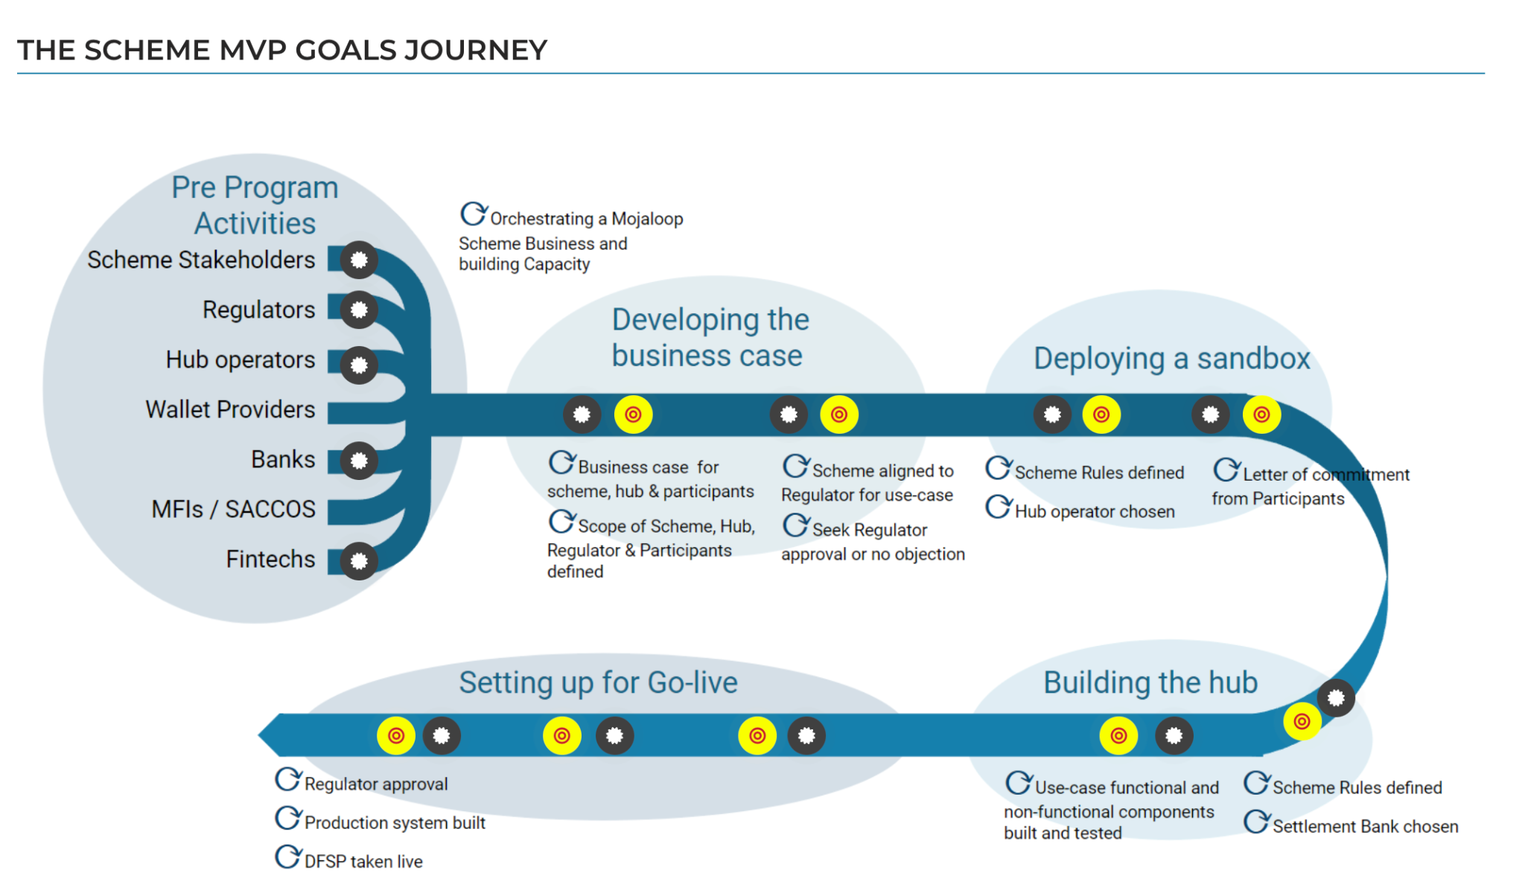
Available tools
3. INFITX Journey - THE SCHEME MVP GOALS JOURNEY https://infitx.com/capacity-building/supporting-an-inclusive-instant-payment-system-build/
Notes:
This is the Journey as defined by the INFITX team and shared with us to enable us to start creating a similar structured approach to the Journey.

Slide 11
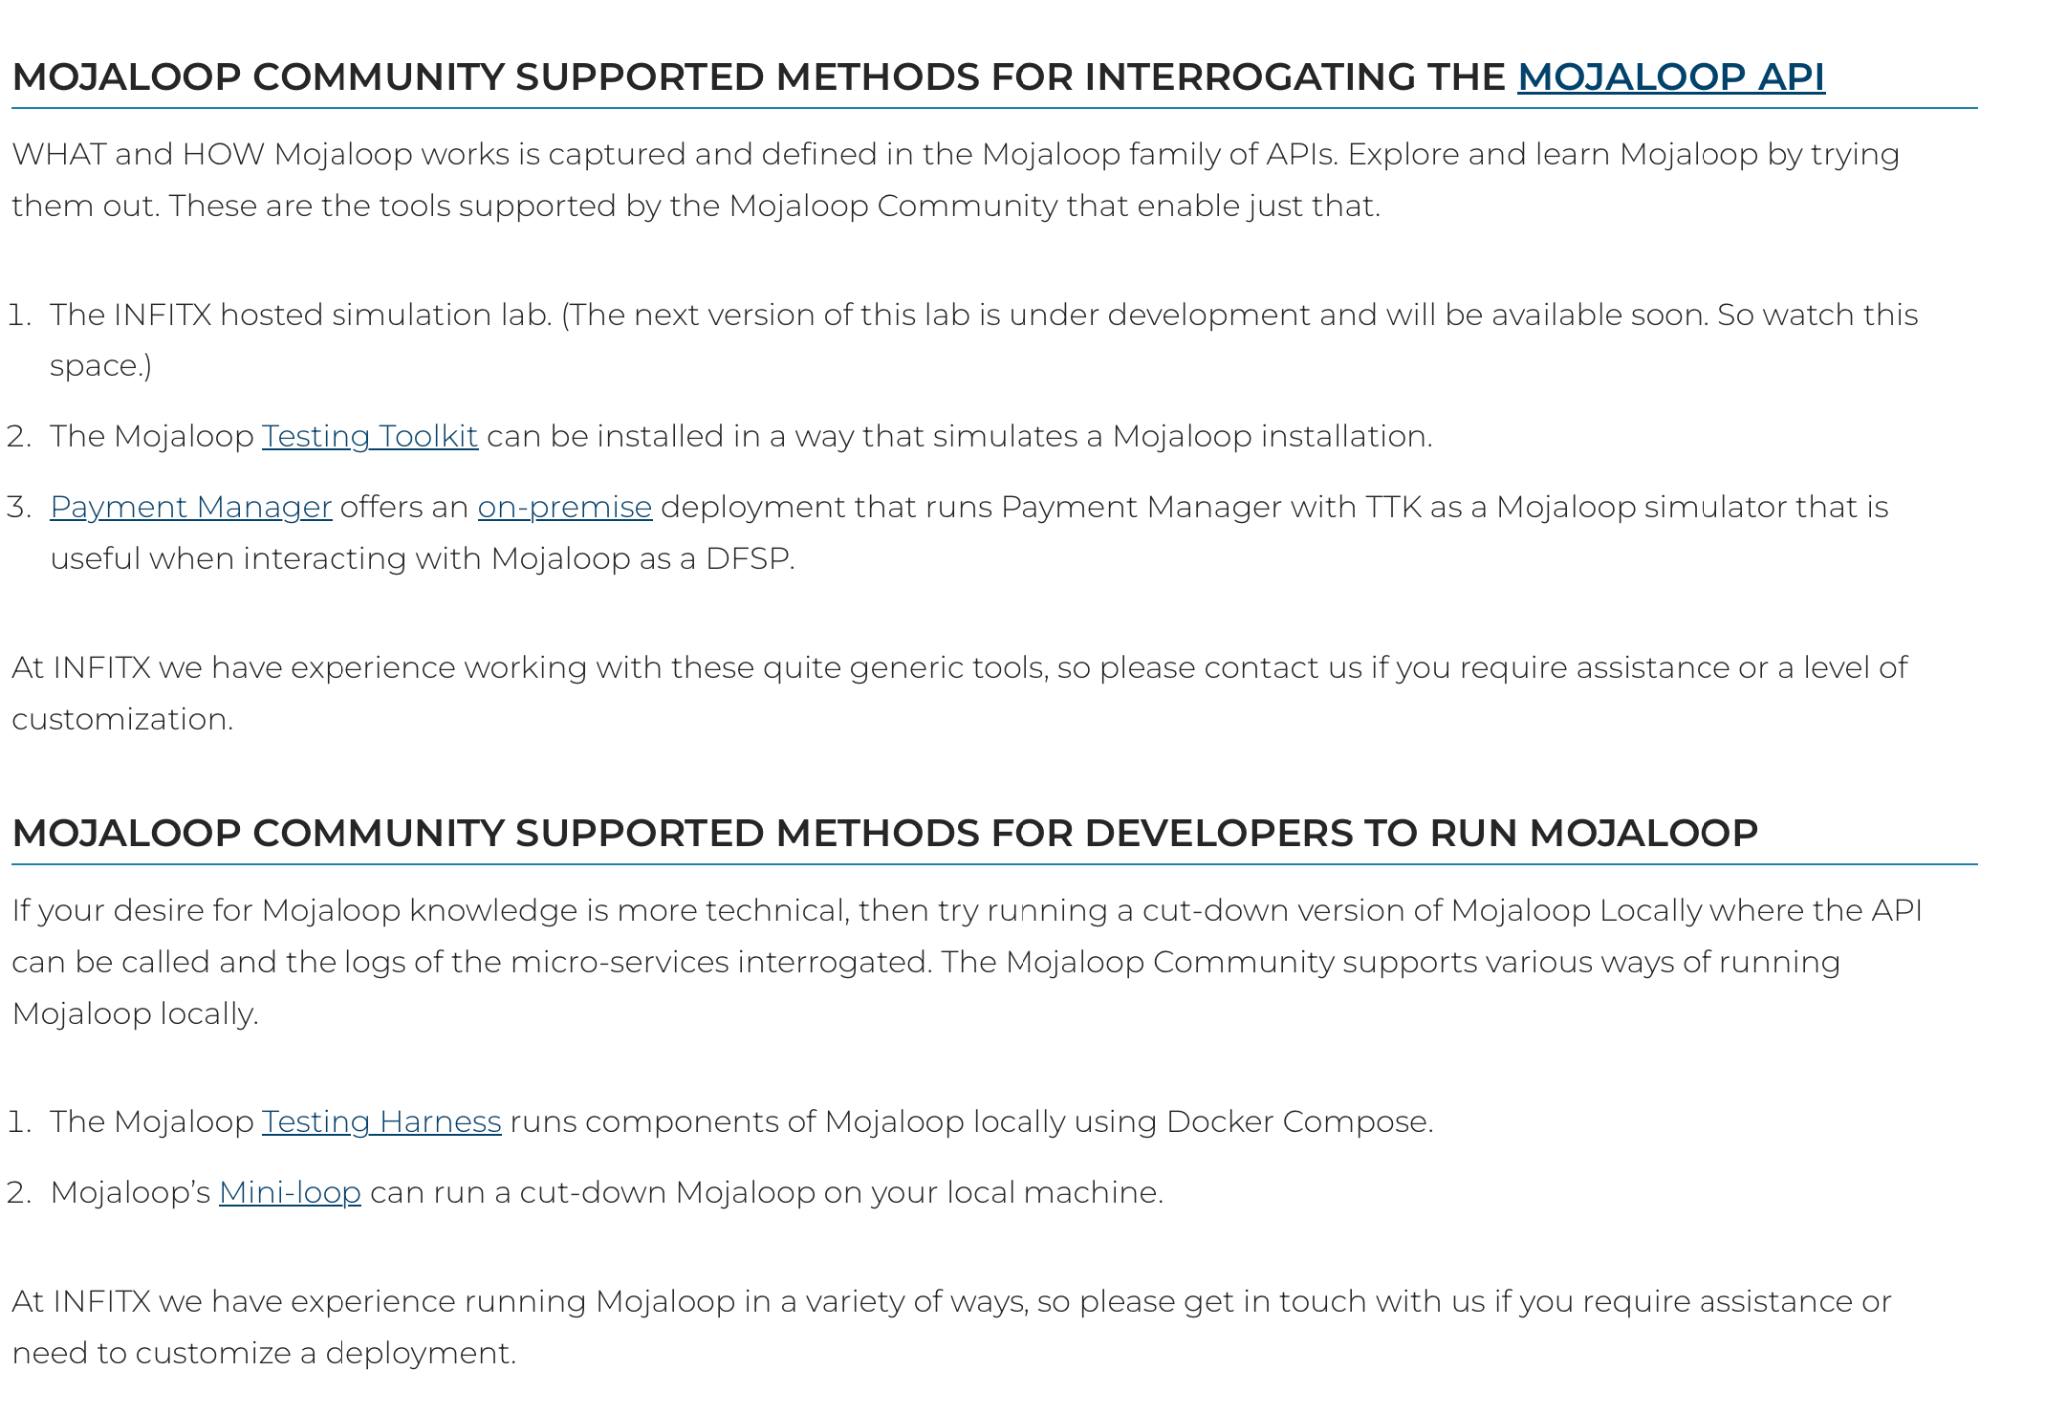
Available tools
4. Mojaloop Lab - https://infitx.com/capacity-building/mojaloop-lab/
Notes:
The INFITX thinking as described on their website supports the Mojaloop concepts for providing opportunities to new participants and interested parties to experiment and build knowledge around the Mojaloop API. This thinking will be part of the set up section in the Journey Roadmap as we develop it.

Slide 12
Available tools
5. Mojaloop Fintech Sandbox
An exciting new initiative that has been initiated by the Mojaloop Foundation.
Details will be published by the Foundation in the near future. Should you be interested in access to this, how it will work please contact Simeon, Steve or Desire.

Slide 13
3. Community Influencers
Who is considered and influencer?

Slide 14
4. Map the path to a POC
Instead of trying to capture the entire roadmap from inception to a live system, we agreed to tackle this work in phases.
The path to achieving a POC - enabling the interested parties to prove concepts that can assist in decision making
The path to a Pilot. Testing the proven concepts and delivering an MVP
The path to a full live deployment
NOTE: All of these definitions are to be clarified as part of this workstream

Slide 15
Path to POC
Define key stakeholders
Define POC governance
Define learning objectives for all stakeholders
What do they need to know to support a decision?
What do they need to know to assess value?
What do they need to know to assess cost?

Slide 16
Path to POC
Potential Learning Objectives
Can banks and non-banks easily connect?
What is the impact of non-bank operations?
How does security work?
How are settlement windows opens and closed?
How are settlement instructions sent to the central bank?
How quickly can a local system integrator learn to maintain Mojaloop?

Slide 17
Contributors
Thank you to:
Steve Hayley
Paul Makin
John Muthiora
Salvador Chang
Pyae Phyo Lwin
Jane Stroucken

